Slide 1
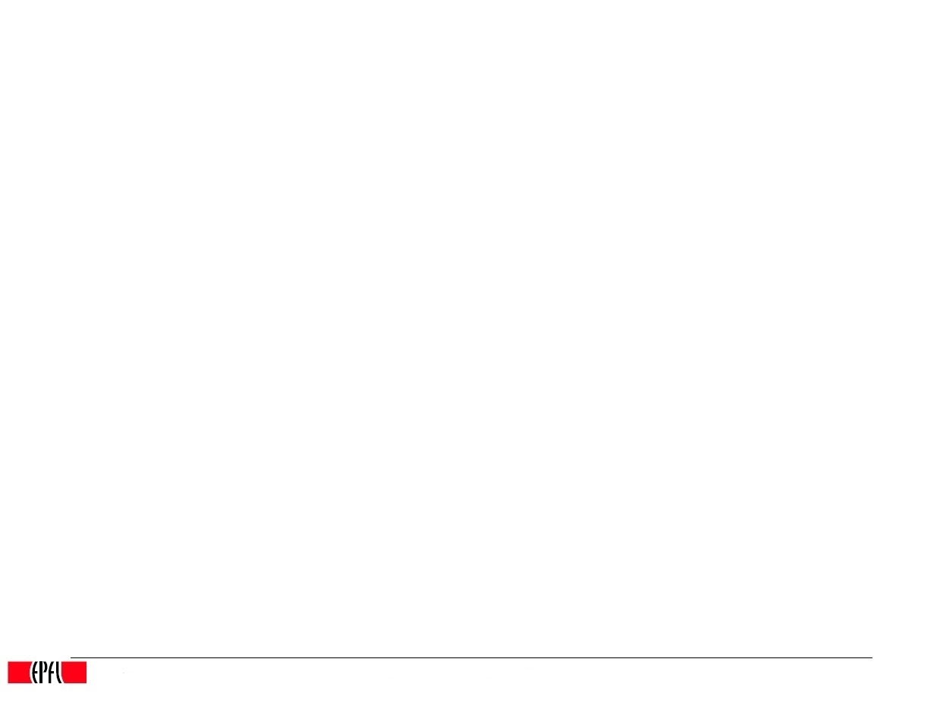
Performance analysis of multi-threading in In-Memory Data-Stores
Grégory Ludovic Maitre
Patrick Daniel Oliveira Andrade
1st May 2015

Slide 2
Outline
Goal
Load and metrics
Factors
Method
Experiments
Numerical Analysis

Slide 3
Goal
Evaluate the performance of all the architectures of In-Memory Data-Stores that we built
Compare the performances between the different architectures
Give suitable architecture depending on average clients served
Performance analysis will be, in this case, analysis of the average waiting time of a client for an answer after performing a request to the data-store

Slide 4
Load and metrics
Load generated by benchmarks that send randomly requests to get/set data with some random key in a range of one hundred predefined keys and with some random value in a range of one hundred predefined values.
Metric is to compare between the different architectures using the average response time of any request to the different data-stores

Slide 5
Factors
For the first batch of results, mostly network factor. However, for the metric this should not be a problem since it will act on the results as a constant (if the load of the network does not vary a lot).
For the second batch of results, network factor will probably be negligible since the load will be generated in a closed network containing only two machines (i.e. the server and the clients)

Slide 6
Method
As previously mentioned, running benchmarks to evaluate the average waiting time for an answer coming from the data-store.

Slide 7
Experiments
For now, only a growing experiment has been done. For each client, hundred get/set requests over hundred predefined keys. Number of parallel clients accessing the server grows from 1 to 500. Every data-store has been tested.
Next experiment will be to have confidence intervals for fixed number of clients.

Slide 8
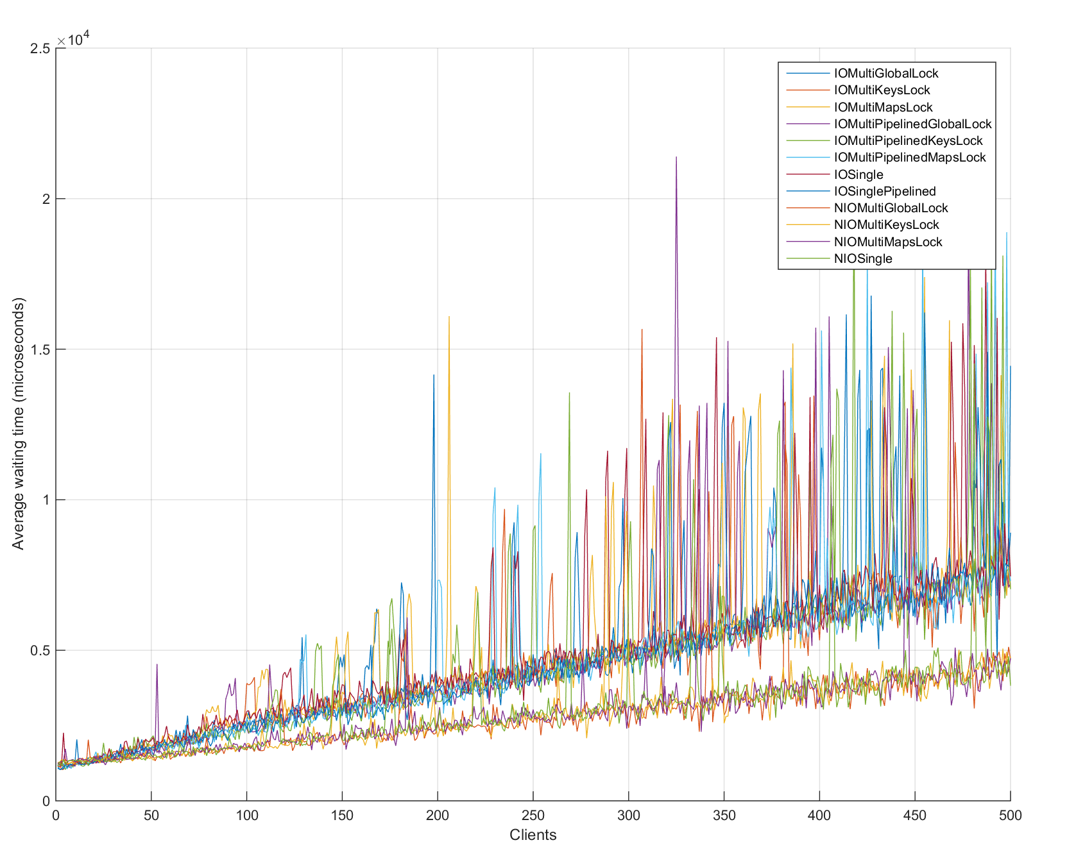
Numerical analysis
Clearly, NIO is better than classical IO of java. Average waiting time at load 100 clients using IO server is quite the same as for 200 client using NIO server.
As first analysis, the growth of the waiting time seems linear in both cases (IO / NIO).

